Slide 1
Driver Drowsiness Monitoring System Using Visual Behaviour
Under the Supervision of
Ms. Sk. Mulla Almas, M.Tech Assistant Professor

Slide 2
CONTENTS
Abstract
Modules
Execution and Testing

Slide 3
Abstract
Drowsy driving is one of the major causes of road accidents and death. Hence, detection of driver’s fatigue and its indication is an active research area.
Most of the conventional methods are either vehicle-based, behavioral-based or physiological-based. Few methods are intrusive and distract the driver, some require expensive sensors and data handling.
Therefore, in this project, a low-cost, real-time driver’s drowsiness detection system has been developed by us with acceptable accuracy. In the developed system, a webcam records the video and the driver’s face is detected in each frame employing image processing techniques.
Facial landmarks on the detected face are pointed and subsequently the eye aspect ratio(EAR), mouth opening ratio(MOR) and nose length ratio(NLR) are computed and depending on their values, drowsiness is detected based on developed adaptive

Slide 4
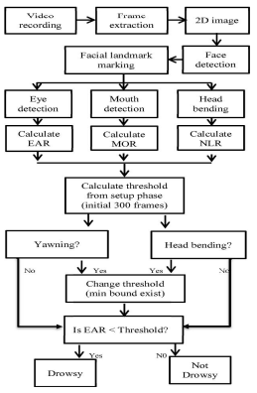
Architecture of the System

Slide 5
MODULES
Tkinter:
Tkinter is a python framework provides Python users with a simple way to create GUI elements using the widgets found in the Tk toolkit. Tk widgets can be used to construct buttons, menus, data fields, etc. in a Python application.
Scipy:
SciPy, a scientific library for Python is an open source, BSD-licensed library for mathematics, science and engineering. The SciPy library depends on NumPy, which provides convenient and fast N-dimensional array manipulation. The main reason for building the SciPy library is that, it should work with NumPy arrays.

Slide 6
MODULES
imutils:
imutils is a package based on OpenCV, which can call the opencv interface more simply. It can easily realize a series of operations such as image translation, rotation, scaling, skeletonization and so on.
argparse:
The argparse module in Python helps create a program in a command-line-environment in a way that appears not only easy to code but also improves interaction. The argparse module also automatically generates help and usage messages and issues errors when users give the program invalid argument.

Slide 7
MODULES
Cv2:
OpenCV stands for Open Source Computer Vision Library, which is widely used for image recognition or identification. It is a library in python, bindings designed to solve computer vision problems. Cv2 is a function which is used to read and display the images.
NumPy :
It is a library consisting of multidimensional array objects and a collection of routines for processing arrays. Using Numpy, mathematical and logical operations on arrays can be performed.

Slide 8
MODULES
playsound:
playsound is a “pure Python, cross platform, single function module with no dependencies for playing sounds.” With this module, you can play a sound file with a single line of code: from playsound import playsound playsound('myfile.wav’)
time:
Python's time module offers a wide variety of time-related features and is often handy when building your backend with Python. Using this library, you can fetch the current time and date in standard formats.

Slide 9
MODULES
dlib:
dlib is a toolkit for making real world machine learning and data analysis applications in C++. While the library is originally written in C++, it has good, easy to use Python bindings. It can be majorly used for face detection and facial landmark detection.
To implement dlib module in python we are incorporating a software known as CMAKE.
CMake:
CMake is used to control the software compilation process using simple platform and compiler independent configuration files, and generate native makefiles and workspaces that can be used in the compiler environment of your choice.

Slide 10
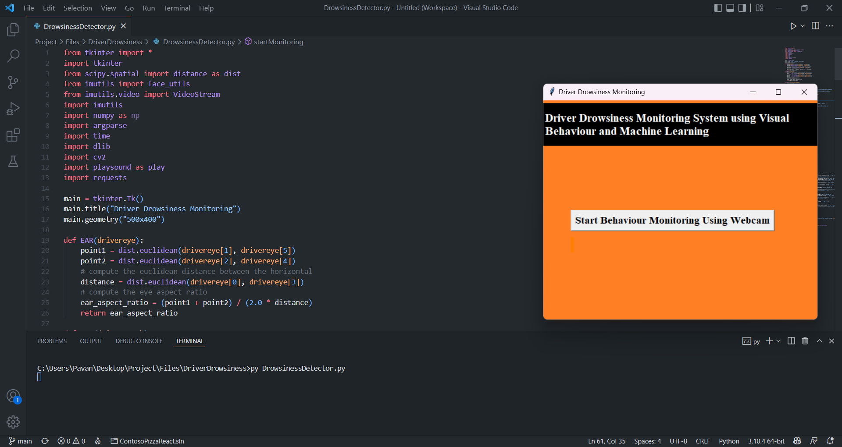
Execution and Testing

Slide 11
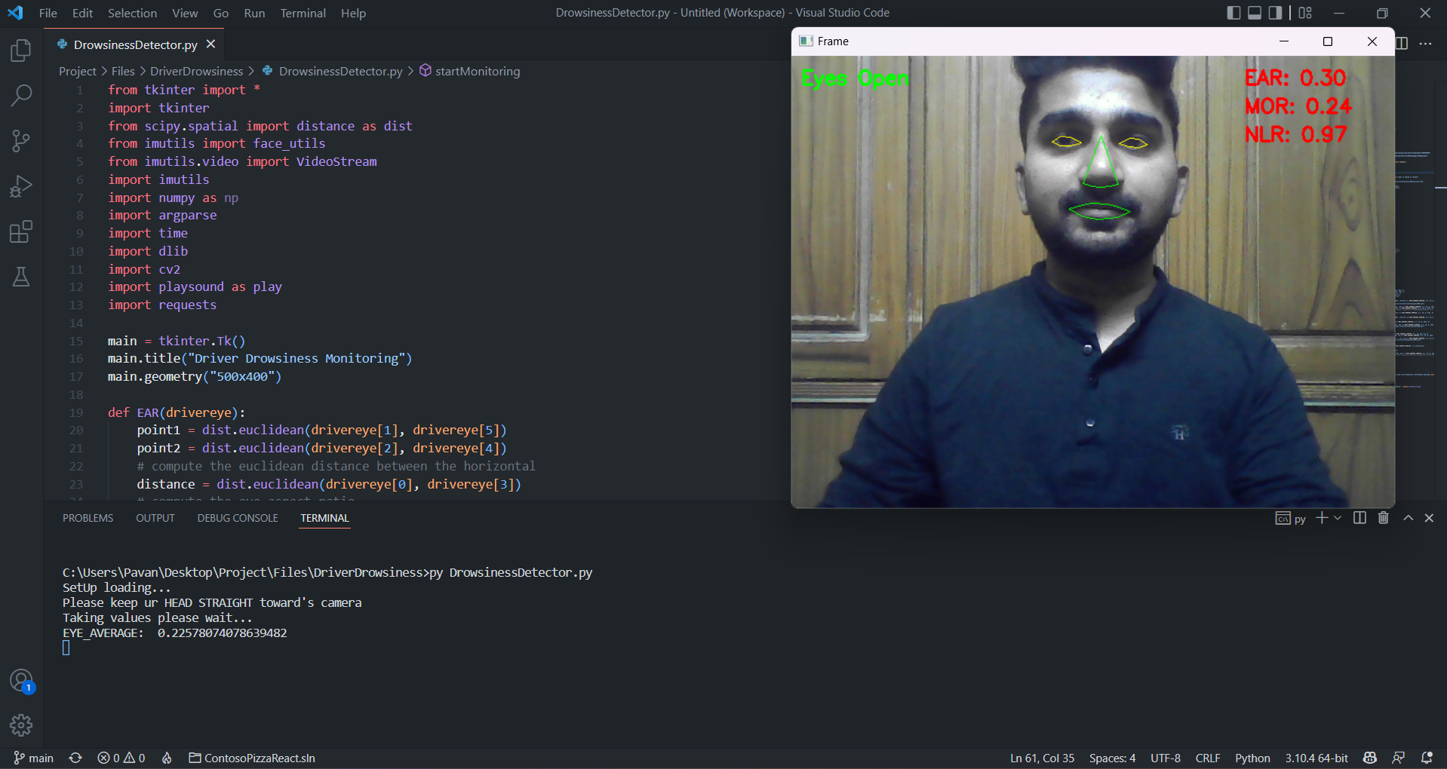
Execution and Testing

Slide 12
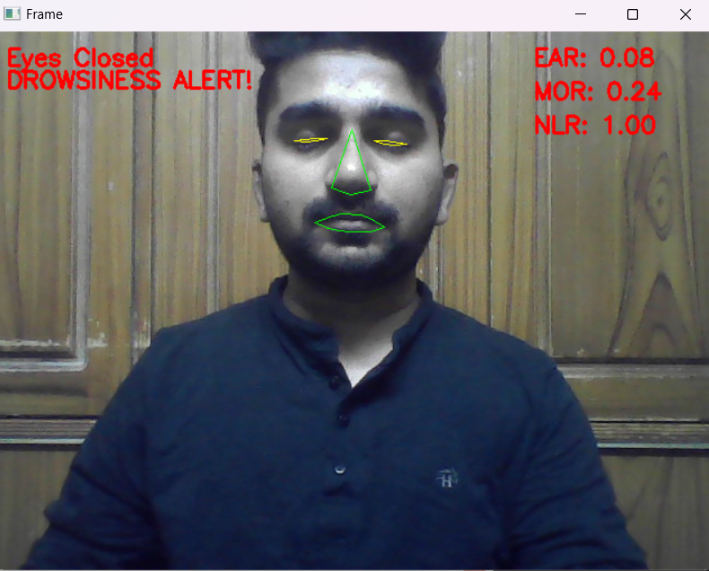
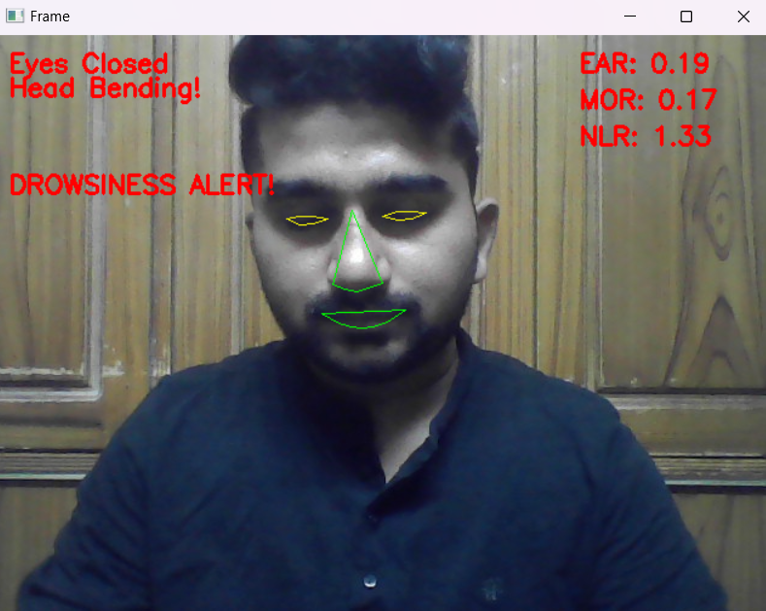
Execution and Testing

Slide 13
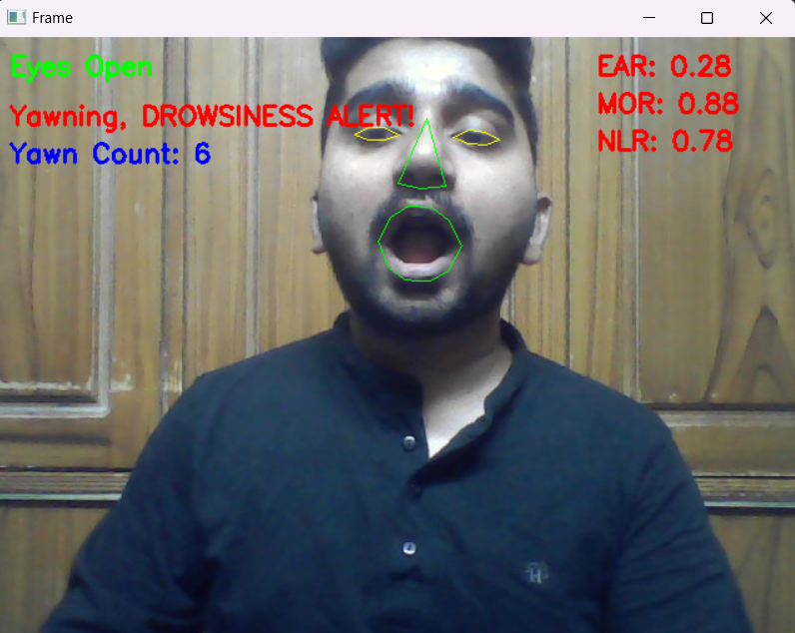
Execution and Testing

Slide 14
THANK YOU
Presented By:
Thota Charan-18BQ1A12G0
Satenapalli Srinivas Rao-18BQ1A12D9.
Rapolu Pavan Kumar-18BQ1A12D2

